Slide 1
Feature selection
This is a technique that is aimed at reducing the number of predictor variables in a model to mainly improve model performance without changing the form of the remaining variables.

Slide 2
Why
To improve model accuracy
To eliminate excess data attributes that do not contribute to model performance.
Reduces data volume and hence time for training the model and cost in terms of CPUs when dealing with huge datasets

Slide 3
When to perform feature selection
After data cleansing, data processing and exploratory data analysis.
How feature selection methods are carried out
Filter methods
Correlation coefficient tests, chi-square tests, information gain.
Wrapper methods
Recursive feature elimination
Forward selection
Backwards elimination.
Embedded methods
Regularization methods

Slide 4
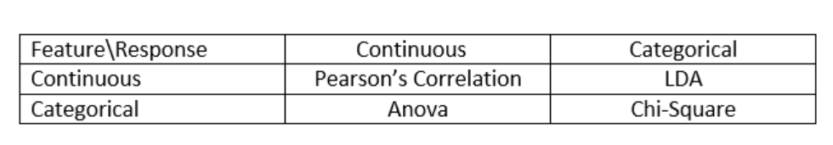
Filter methods
These methods utilize statistical tests like correlation, chi-square anova and Linear discriminant analysis to eliminate insignificant predictors. The tables shows how to determine the tests to carry out based on the datatype.

Slide 5
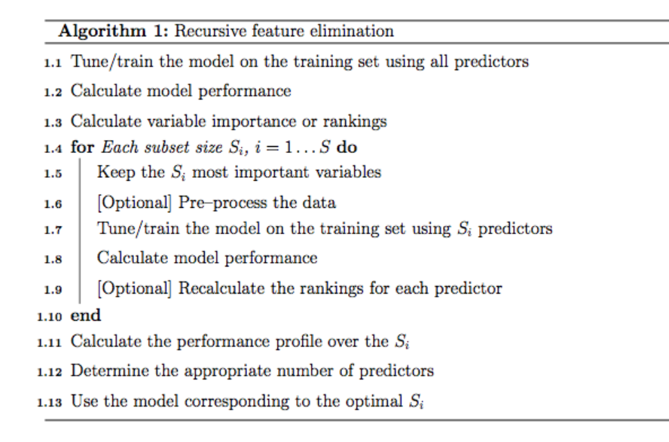
Wrapper methods
Recursive feature elimination

Slide 6
Forward and backward methods
Forward selection adds one feature at a time as the model performamce is observed to see which features improve performance, until when a feature does not improve model performance.
Backward elimination begins with all features and insignificant features are removed iteratively until there are no more non significant features.

Slide 7
Embedded methods
Performed by adding an extra term to the cost function of Linear Regression. This apart from preventing overfitting also reduces the coefficients of less important features to zero.
Examples :Lasso and Ridge regression

